Slide 1
CS-363:
Parallel and Distributed Computing

Slide 2
Text Book
Introduction to Parallel Computing by Ananth Grama and Anshul Gupta
Distributed Systems: Concept and Design by George Coulouris, Gordon Blair
Using OpenMP: Portable Shared Memory Parallel Programming by Barbara Chapman, Gabriele Jost, Ruud van der Pas

Slide 3
Lecture 1: Introduction
By
Dr. Tariq Sadad

Slide 4
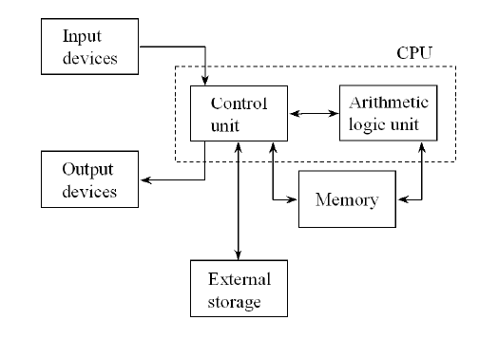
von Neumann Architecture

Slide 5
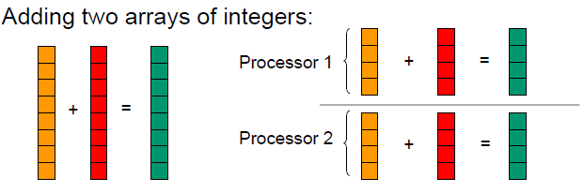
Parallel and Distributed Computing
Parallel computing (processing):
the use of two or more processors, usually within a single system, working simultaneously to solve a single problem.
Distributed computing (processing):
any computing that involves multiple computers remote from each other that each have a role in a computation problem or information processing.
Parallel programming:
the human process of developing programs that express what computations should be executed in parallel.

Slide 6
What is Parallel Computing?
Serial Computing:
Traditionally, software has been written for serial computation:
A problem is broken into a discrete series of instructions
Instructions are executed sequentially one after another
Executed on a single processor
Only one instruction may execute at any moment in time

Slide 7
CPU and Memory Speeds
In 20 years, CPU speed (clock rate) has increased by a factor of 1000
DRAM speed has increased only by a factor of smaller than 4
How to feed data faster enough to keep CPU busy?
CPU speed: 1-2 ns
DRAM speed: 50-60 ns
Cache: 10 ns

Slide 8
CPU, Memory, and Disk Speed

Slide 9
Possible Solutions
Distributed Data Communications
Data may be collected and stored at different locations
It is expensive to bring them to a central location for processing
Many computing assignments many be inherently parallel
Privacy issues in data mining and other large scale commercial database manipulations

Slide 10
Distributed Data Communications

Slide 11
Why Use Parallel Computing
Save time – wall clock time – many processors work together
Solve larger problems – larger than one processor’s CPU and memory can handle
Provide concurrency – do multiple things at the same time: online access to databases, search engine
Google’s 4,000 PC servers are one of the largest clusters in the world

Slide 12
Why Parallel Computing?
To solve larger problems
– many applications need significantly more memory than a regular PC can provide/handle
To solve problems faster
– despite of many advances in computer hardware technology, many applications are running slower and slower
• e.g. databases having to handle more and more data
• e.g. large simulations working on even more accurate
solutions

Slide 13
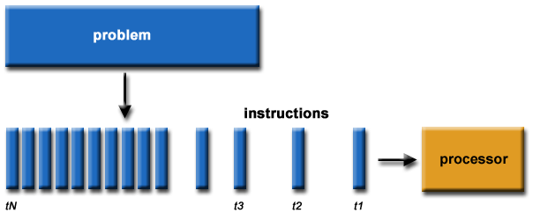
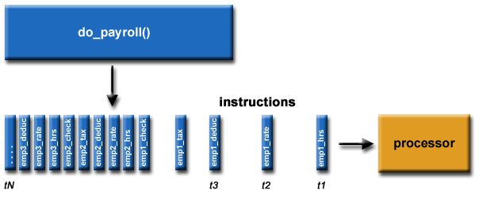
Serial execution

Slide 14
Parallel Computing:
In the simplest sense, parallel computing is the simultaneous use of multiple compute resources to solve a computational problem:
A problem is broken into discrete parts that can be solved concurrently
Each part is further broken down to a series of instructions
Instructions from each part execute simultaneously on different processors
An overall control/coordination mechanism is employed

Slide 15
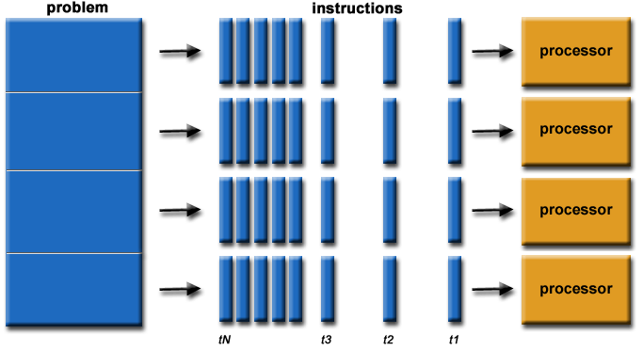
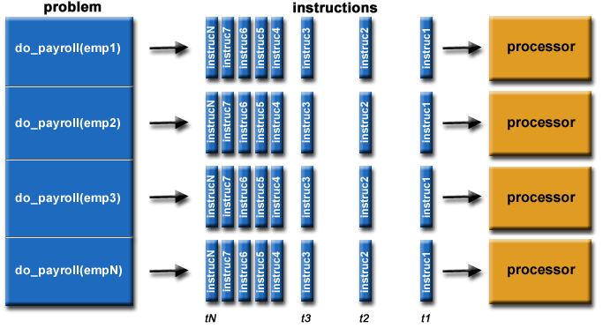

Slide 16
The Inherent Need for Speed
We want things done fast. If we can get it by the end of the week, we actually want it tomorrow. If we can get it tomorrow, we would really like it today. Let's face it, we're a society that doesn't like to wait.
Just think about the last time you stood in line at a fast food restaurant and had to wait for more than a couple of minutes for your order.
This idea extends to other things like the weather. We routinely check the hourly forecast to see what the weather will be like on our commute to and from work. We expect that there is a computer, behind the scenes, providing this information.

Slide 17
But did you know that a single computer is often not up to the task? That is where the idea of parallel computing comes in.

Slide 18
Parallel Computing
In simple terms, parallel computing is breaking up a task into smaller pieces and executing those pieces at the same time, each on their own processor or on a set of computers that have been networked together. Let's look at a simple example. Say we have the following equation:
Y = (4 x 5) + (1 x 6) + (5 x 3)
On a single processor, the steps needed to calculate a value for Y might look like:
Step 1: Y = 20 + (1 x 6) + (5 x 3)
Step 2: Y = 20 + 6 + (5 x 3)
Step 3: Y = 20 + 6 + 15
Step 4: Y = 41

Slide 19
But in a parallel computing scenario, with three processors or computers, the steps look something like:
Step 1: Y = 20 + 6 + 15
Step 2: Y = 41
Now, this is a simple example, but the idea is clear. Break the task down into pieces and execute those pieces simultaneously.

Slide 20
Parallel Vs Distributed Computing
Parallel computing is a computation type in which multiple processors execute multiple tasks simultaneously.
Distributed computing is a computation type in which networked computers communicate and coordinate the work through message passing to achieve a common goal.
Number of Computers Required
Parallel computing occurs on one system.
Distributed computing occurs between multiple system.
Processing Mechanism
In parallel computing multiple processors perform processing.
In distributed computing, computers rely on message passing.

Slide 21
Memory
In Parallel computing, computers can have shared memory or distributed memory.
In Distributed computing, each computer has their own memory.
Usage
Parallel computing is used to increase performance and for scientific computing.
Distributed computing is used to share resources and to increase scalability.
Synchronization
All processors share a single master clock for synchronization.
There is no global clock in distributed computing, it uses synchronization algorithms.
Notes:
http://csharpbrains.blogspot.com/2012/08/difference-between-distributed-and.html

Slide 22
Task 1

Slide 23
The fastest computer in the world today
What is its name?
Where is it located?
How many processors does it have?
What kind of processors?
How fast is it?
Notes:
See http://www.top500.org

Slide 24
The fastest computer in the world today
What is its name? IBM Summit
Where is it located? United States
How many processors does it have? 4,611,236 processor cores
What kind of processors? 9216 POWER9 22-core CPUs; 27,648 Nvidia Tesla V100 GPUs
How fast is it? 122.3 pFLOPS
Notes:
See http://www.top500.org

Slide 25
Task 2

Slide 26
`
Just revise the following basic concepts:
Architecture of microprocessor
Types of Registers
Types of memory

